Slide 1

Oakland Care
Gender Pay Gap Report
April 2023

Slide 2
Summary
This Gender Pay Gap report is for the snapshot date of 5th April 2023.
The report shows that our Gender Pay Gap has improved for Oakland Primecare Ltd compared to figures reported for April 2022. The detail is out in the body of this report.
Mandatory metrics for Oakland Care’s gender pay gap are set out in the body of this report.
The report has been prepared on Oakland Care’s behalf by Gapsquare using salary data from Oakland Primecare’s payroll. Additionally, Gapsquare has provided relevant benchmarks to enable us to see how our gender pay gap compares with other similar organisations.
This report includes all the figures required for Gender Pay Reporting under the Employment Equality Act 1998 (Section 20A) (Gender Pay Gap Information) Regulations 2022.
We submitted data for a total of 551 employees of which 458 were categorised as relevant (True) employees ie employees who received full contractual pay during the snapshot period of April 2023 (106 males and 352 females).
93 employees were categorised as ‘false’ and are excluded from the report due to being for example on maternity leave or long-term sickness absence.
The data submitted is in relation to Oakland Primecare locations only i.e. Beechwood Grove, Elmbrook Court, Elsyng House, Lambwood Heights and Woodland Grove.

Slide 3

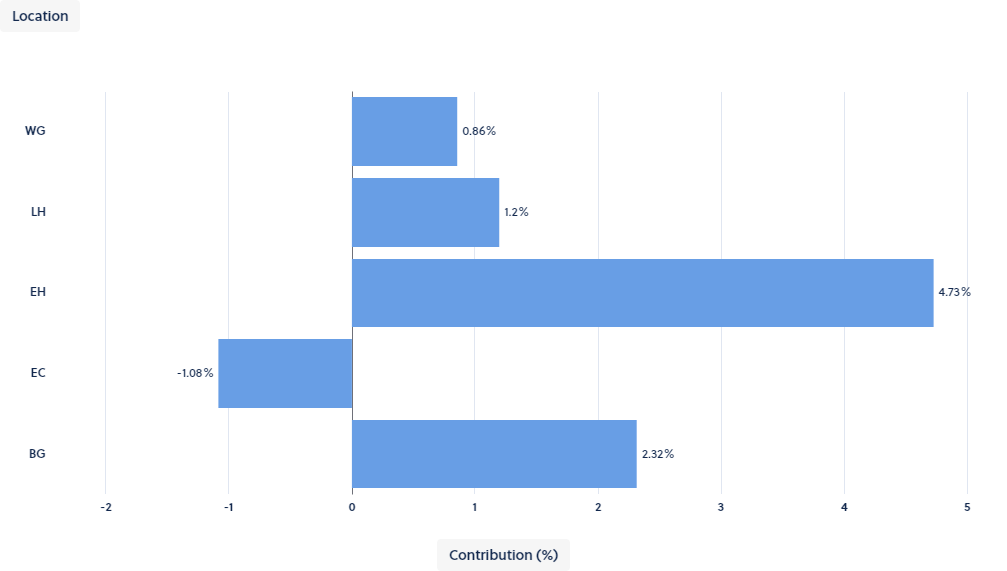

OUR GENDER PAY GAP Headline Figures
GENDER PAY GAP
Contribution
This graph shows how each location contributes to the overall pay gap.
Contribution can be a positive number i.e. the location is contributing to increasing the overall gap, or it can be a negative number, which means the location is contributing to reducing the overall gap. This in turn helps to pin-point any areas that may need addressing (i.e. if it is a positive number).
Last year the highest contributor towards our mean pay gap was EH with 15%. This year that trend continues, however figures for April 2023 (4.73%) show that EH’s contribution to the gender gap has decreased significantly compared to April 2022.
8.03%
[MEAN]
10.29%
[MEDIAN]
The data shows our mean and median hourly gender pay gap, at the snapshot date of 5th April 2023. Although there is a gap, Oakland Care has continued to reduce its mean gender pay gap.
GENDER BONUS GAP
16.15%
MEAN
16.43%
MEDIAN
Our gender bonus gap reflects a bonus pay gap of 16.15%. This means female workers have received £1,720 less than men.
Proportion of Males And Females Receiving A Bonus
Females 1.18% Males 1.55%
Calculations are based on 5 female workers out of a total 422 receiving a bonus and 2 male workers out of a total 129 receiving a bonus.

Slide 4
Gender Pay Gap Trends
We have successfully continued to reduce our Gender Pay Gap year on year since 2019 as the graphs show below. In April 2023, the UK’s gender pay gap for full-time employees was 14.3%, meaning that average pay for full-time female employees was 14.3% lower than for full-time male employees. At 8.03% Oakland Primecare’s gender pay gap is lower than the UK average and is also lower when compared to the average gender pay gap for organisations in the Southeast (12.9%).
At 10.29% Oakland Primecare’s median gender pay gap fell slightly when compared to figures reported for April 2023 and is also lower compared to the UK average for all sectors for 2023 (12%).
Source: Office for National Statistics (ONS) April 2023.
Year | Oakland Primecare Mean Gender Pay Gap (%) | Change From Previous Year (percentage points)
2023 | 8.03 | -1.97
2022 | 10.9 | -11.8
2021 | 22.7 | -3.2
2020 | 25.9 | -9.1
2019 | 35 | 0
Year | Oakland Primecare Median Gender Pay Gap (%) | Change From Previous Year (percentage points)
2023 | 10.29 | --1.31
2022 | 11.6 | 15.2
2021 | -3.6 | -15
2020 | 11.4 | 5.7
2019 | 5.7 | 0

Slide 5
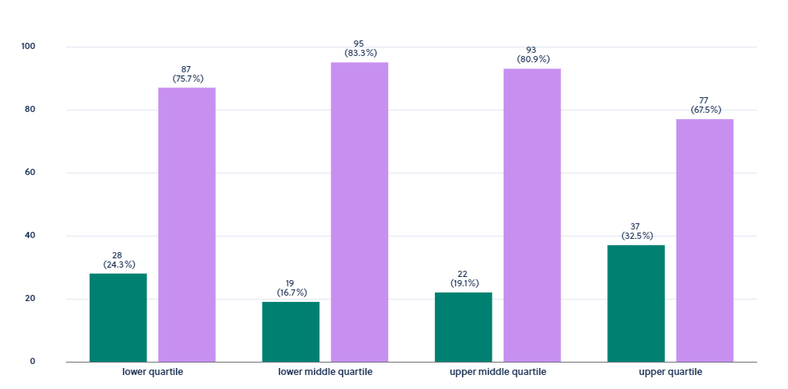
OUR GENDER PAY GAP Headline Figures
How is Our Workforce Made Up?
In the lower quartile, there are 87 (75.65%) number of Female to 28 (24.35%) number of Male.
In the lower middle quartile, there are 95 (83.33%) number of Female to 19 (16.67%) number of Male
In the upper middle quartile, there are 93 (80.87%) number of Female to 22 (19.13%) number of Male.
In the upper quartile, there are 77 (67.54%) number of Female to 37 (32.46%) number of Male.
1 in 5 Female are high earners (upper quartile).
1 in 4 Female are low earners (lower quartile).
Our Gender Pay Gap
The data shows Oakland Primecare has improved its gender pay gap at the reporting date of April 2023 at 8.03% compared to figures reported for April 2022 (10.29%).
The data submitted for this year is based on locations within Oakland Primecare.
For there to be little or no gender pay gap, there would need to be the same ratio of men to women in each quartile band.
Our workforce shows a higher percentage of women within each quartile and accounts for 76.8% of the workforce within Primecare Ltd.
Male
Female

Slide 6
Gender Pay Gap
WHY DO WE HAVE A GENDER PAY GAP?
The data shows Oakland Care has improved its gender pay gap at the reporting date of April 2023 compared to figures reported for April 2022 and continues to trend lower than the UK average.
Our gender pay gap is as a result of the distribution of female workers across the four quartiles and because traditionally female workers are more likely to hold frontline lower paid or part time roles which is also the case in Oakland Primecare. Our workforce has a higher percentage of women within each quartile and women account for 76.8% of the workforce within Primecare Ltd.
We are confident that our gender pay gap is not because we pay men and women differently for the same or equivalent work. Instead, our gender pay gap is because men and women work in different roles and those roles have different salaries. Across the UK economy, women are more likely than men to have had breaks from work that have affected their career progression, for example to bring up children and they are also more likely to work part time, and many of the jobs that are available across the UK on a part-time basis are relatively low paid. This pattern from the UK economy is reflected in the make-up of Oakland Primecare where the majority of part time roles are held by women (146) compared to men (27).
We remain committed to equal opportunities and equal treatment for all employees, regardless of sex, race, religion or belief, age, marriage or civil partnership, pregnancy/maternity, sexual orientation, gender reassignment or disability and we have a clear policy of paying employees equally for the same or equivalent work, regardless of their sex (or anything else listed above).

Slide 7
Gender Pay Gap
ADDRESSING THE GENDER PAY GAP
In 2022, we committed to rolling out the following actions over the course of 2023 and as a reminder these are set out below along with an indication of progress against each action:
  Embed a values based approach to recruitment – we rolled out a recruitment HODs masterclass to further embed our approach to values based recruitment. This is an ongoing programme which is mandatory for all managers in the business (ongoing and completed)
  Implement actions developed as a response to the employee engagement survey – this is ongoing linked to the development of an employee value proposition. (completed)
  Implement a talent management framework to include succession planning and a leadership development programme. The Talent Management Framework and leadership development programme were both launched successfully in 2023. We now have a rolling programme of talent management and leadership development led at SLT level for the business. The next phase of development is to develop a programme for new and aspiring managers in addition to a graduate trainee programme in the long term.
  Embed the reward and recognition framework (completed)
We will continue to embed the actions above and in addition commit to the actions below:
  Continue to embed and monitor the operation of our talent management process, particularly for frontline roles where there is traditionally a higher concentration of female workers.
  Encourage the take up of shared parental leave
  Continue to monitor and report on the gender pay gap

